Slide 1



Engaging the Unengaged
Daniil Rose

Slide 2


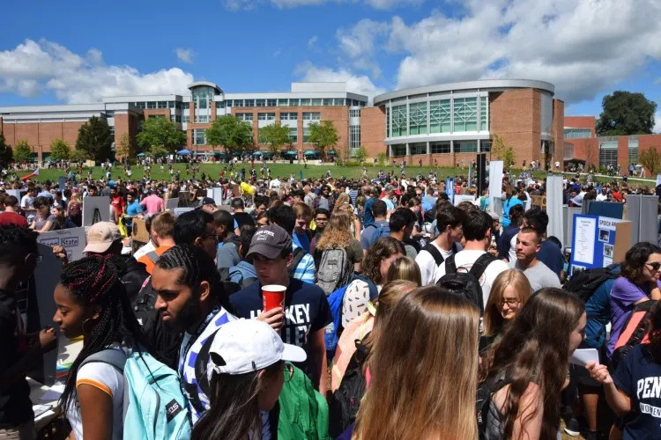
The Challenge
of
Engagement
“Too many options, too little time.”

Slide 3






Breaking Barriers
01
02
03
04
Time
Information Overload
Social Barriers
Finances

Slide 4



Building Bridges
“People join people, not clubs.”

Slide 5

Creating Value
“Engagement creates opportunities, empowers students, and shapes lasting impact.”

Slide 6


As the Pennsylvania State University, we must stay committed to providing opportunities for students to grow and develop as people, and to engage the broader community as a whole.

Slide 7
Thank You
Presented by
Daniil Rose

