Slide 1
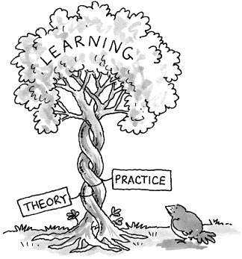
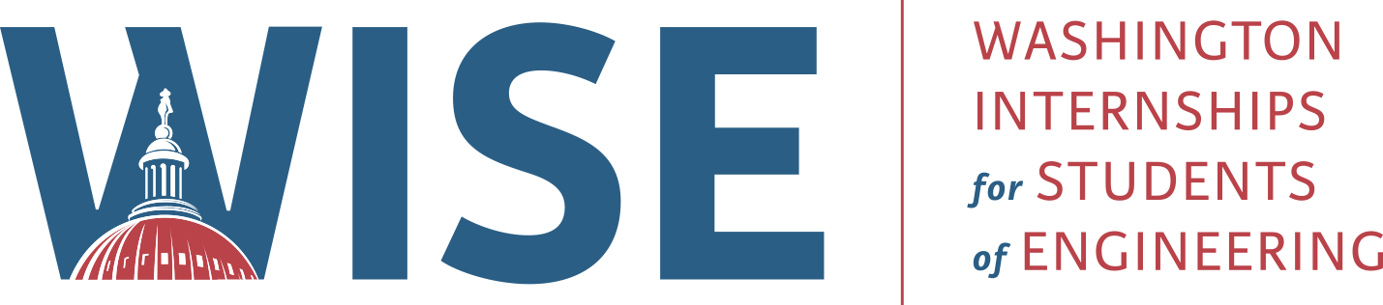

From Labs to Legislation
The Role of Intermediary Organizations in the
Research Ecosystem
Prepared For: IEEE-USA WISE
Daniil Rose
July 23, 2025

Slide 2
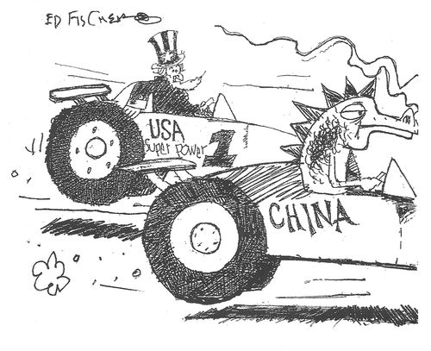
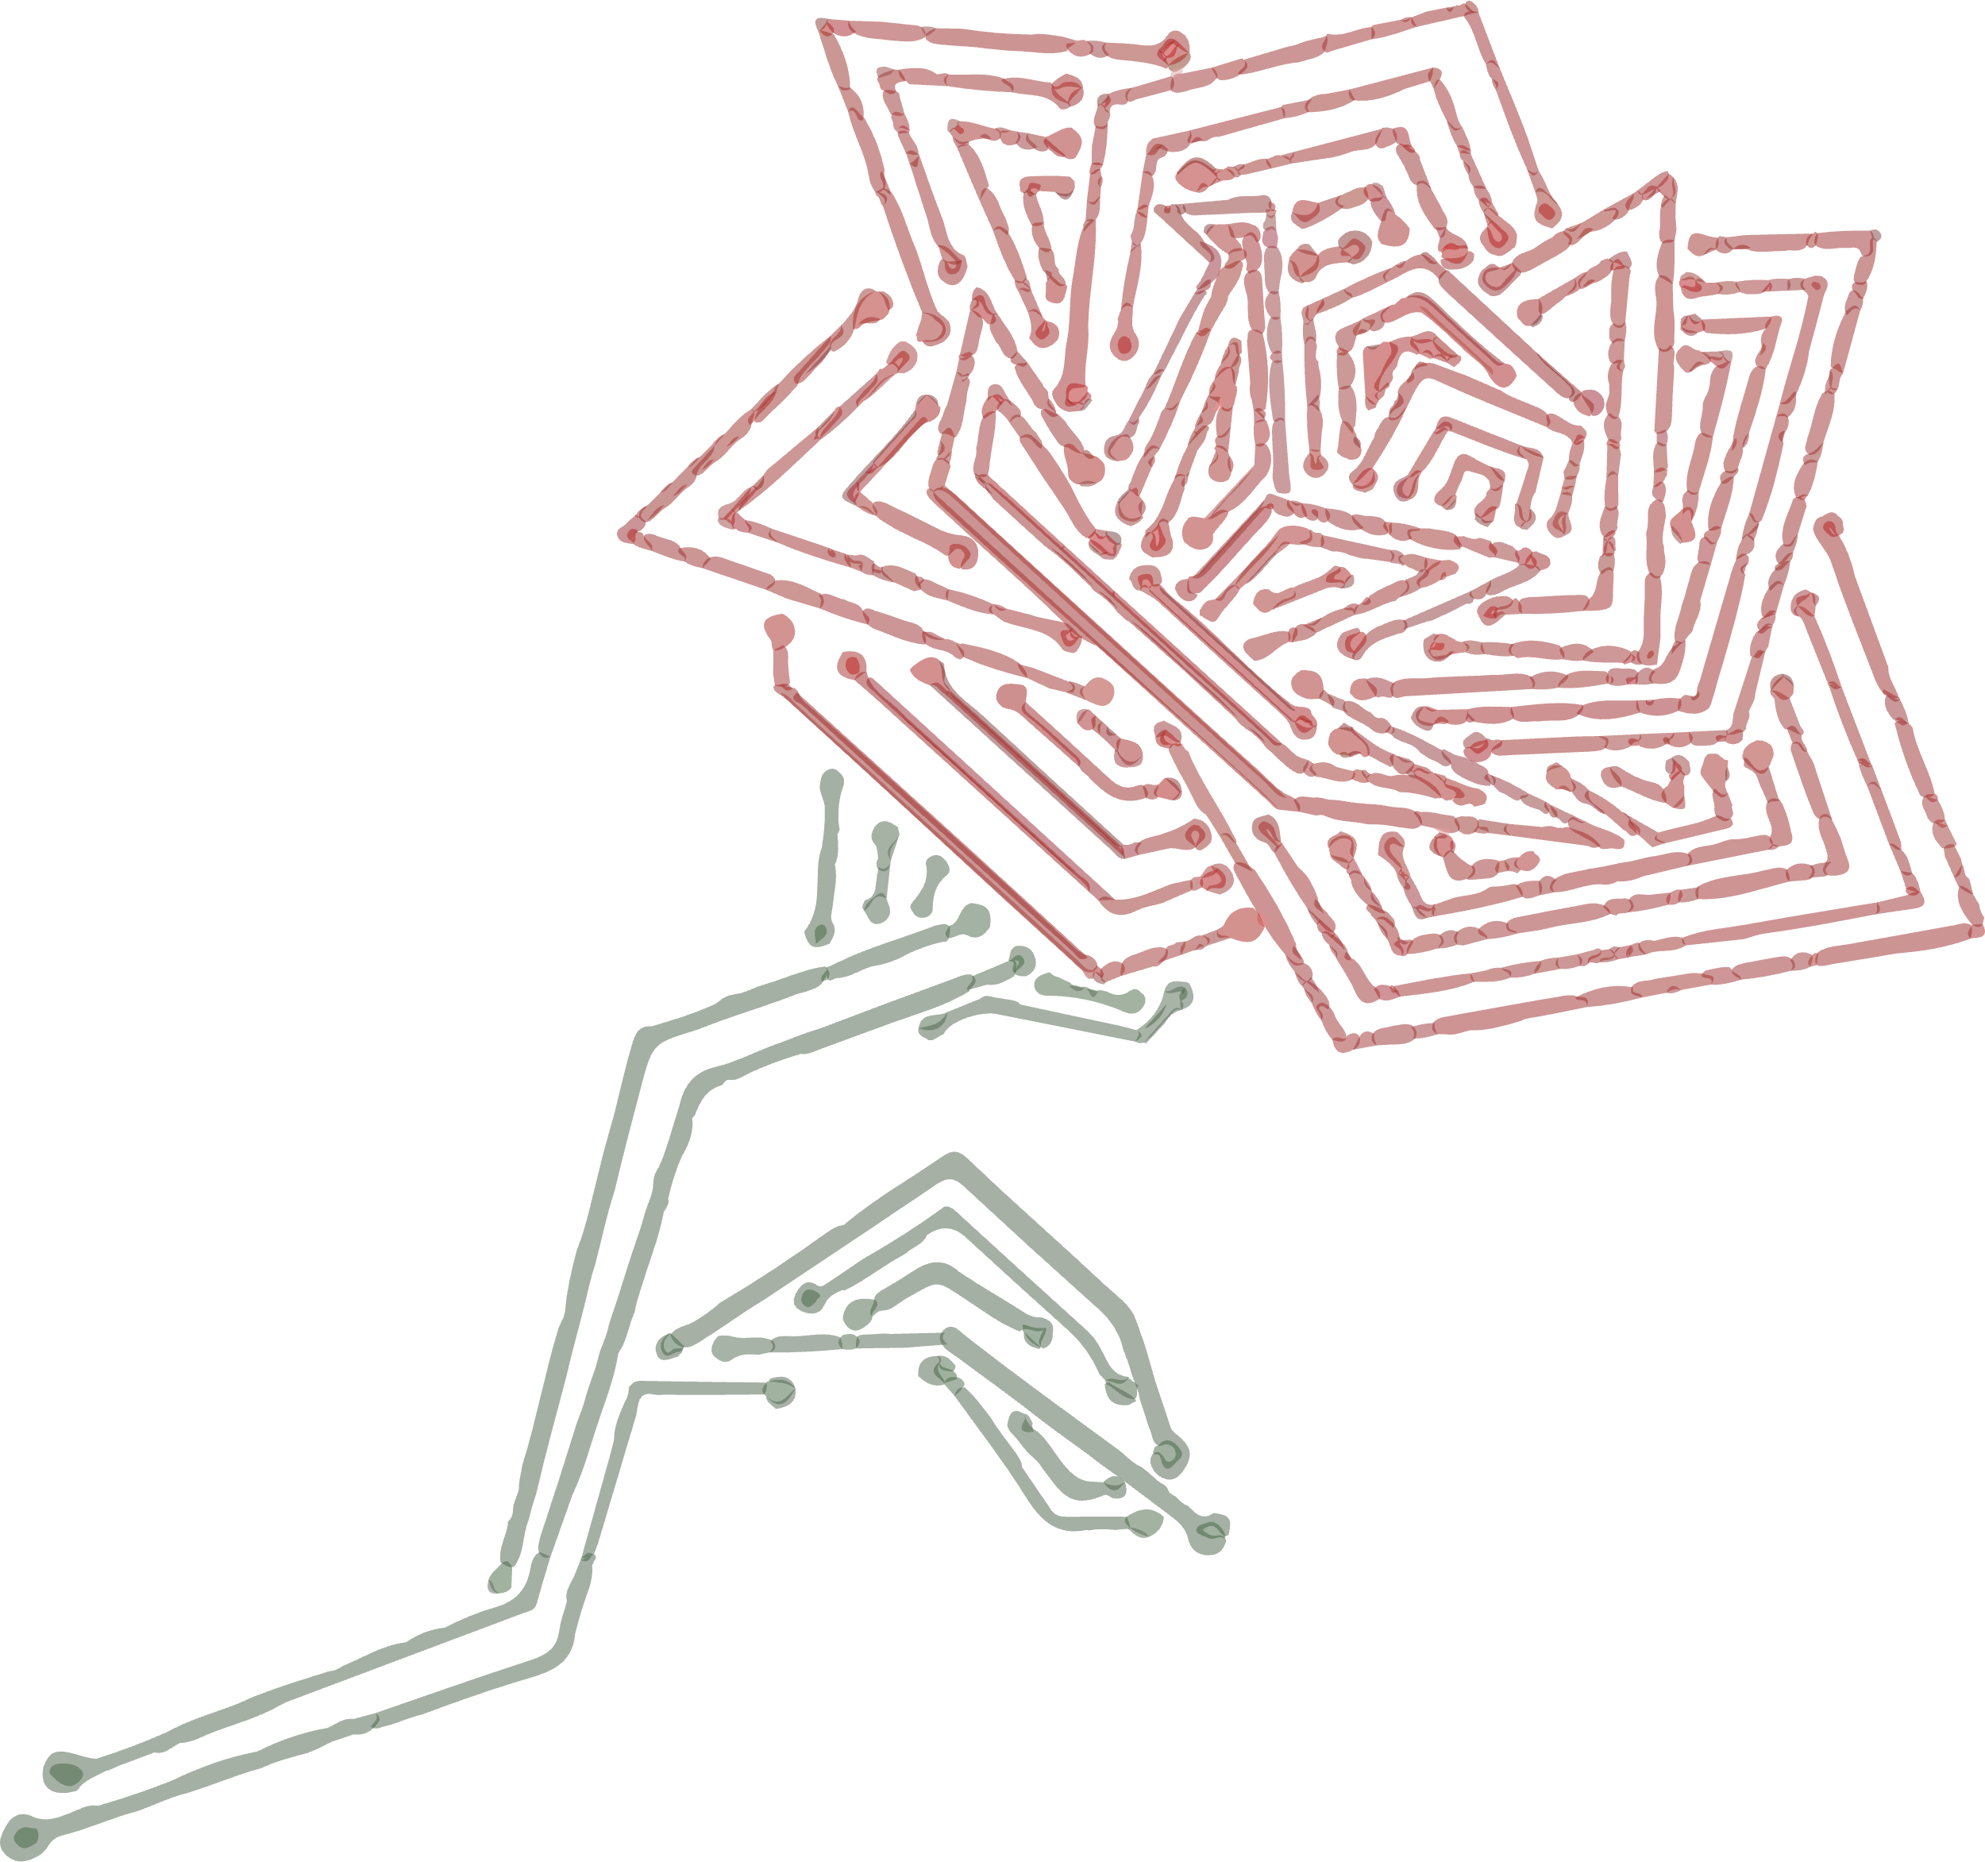
PROBLEM OVERVIEW
Global Competition
Outdated Models
Overlooked Intermediaries
From Labs to
Legislation
2

Slide 3
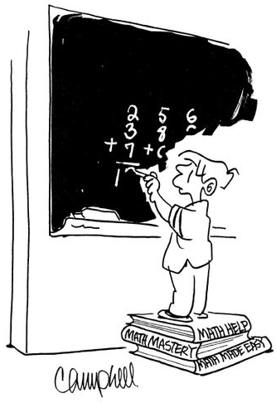
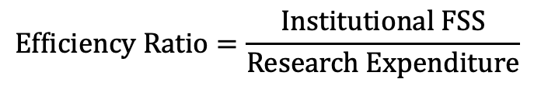
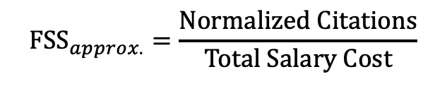
RESEARCH APPROACH
Questions
Definitions
What is an intermediary organization in the context of the research enterprise?
How do government, academia, and intermediaries interact?
What communication breakdowns occur between each actor?
$${\text{FSS}}_{approx.}=\frac{\text{Normalized} \text{Citations}}{\text{Total} \text{Salary} \text{Cost}}$$
$$\text{Efficiency} \text{Ratio}=\frac{\text{Institutional} \text{FSS}}{\text{Research} \text{Expenditure}}$$
From Labs to
Legislation
3

Slide 4
THE RESEARCH TRIAD
The research enterprise is modeled as three nodes:
Universities
Intermediaries
Government
For optimal results, Universities and Government limit direct communication, opting for a translation engine (Intermediaries).
From Labs to
Legislation
4

Slide 5
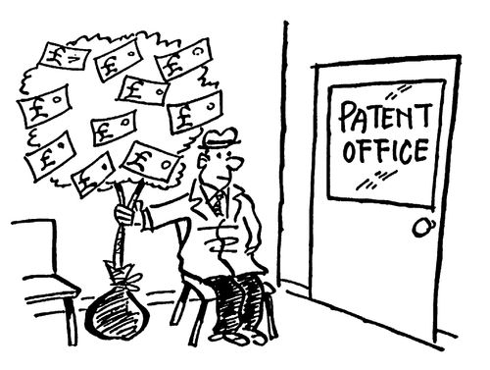

CASE STUDY
We look to AUTM’s role in technology transfer:
From Labs to
Legislation
5

Slide 6
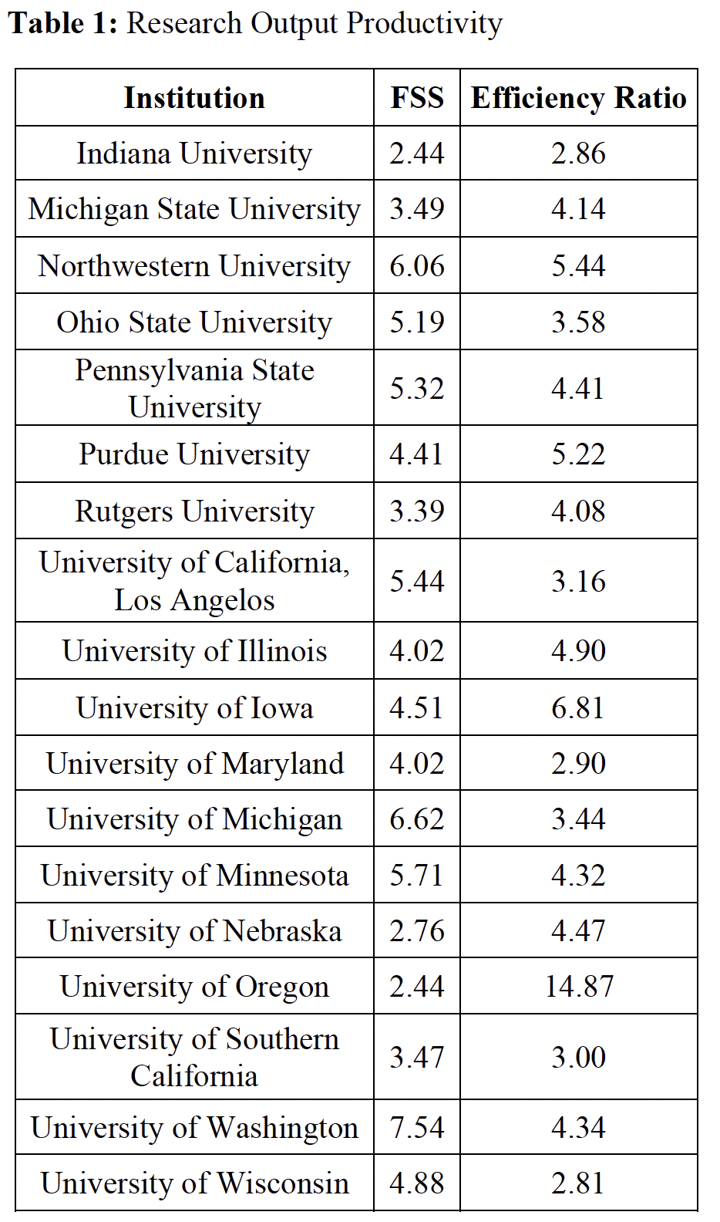
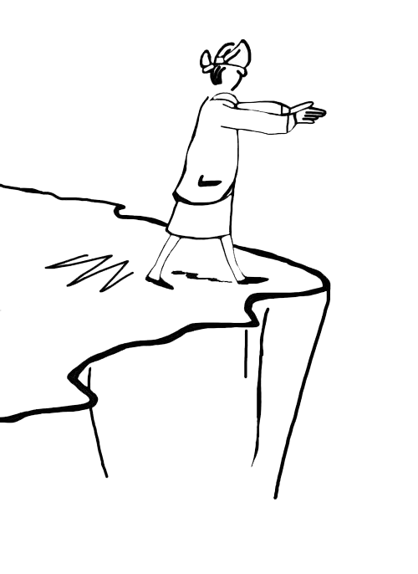
FINDINGS
Applying the model revealed:
Intermediaries Lack Support
Disconnect Between Actors
Lack of Standardization
From Labs to
Legislation
6

Slide 7
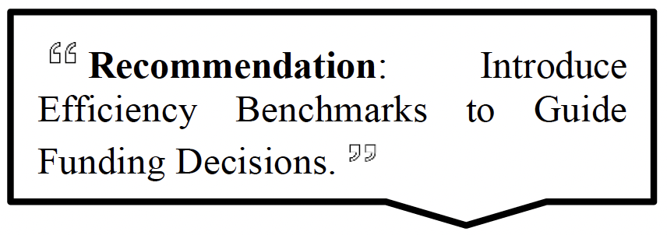
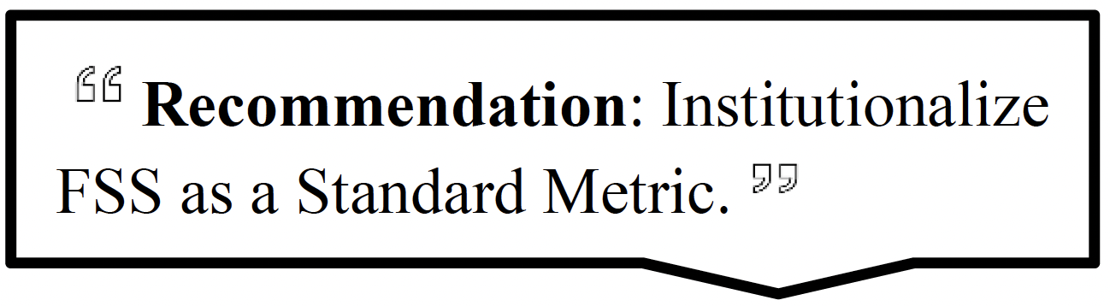
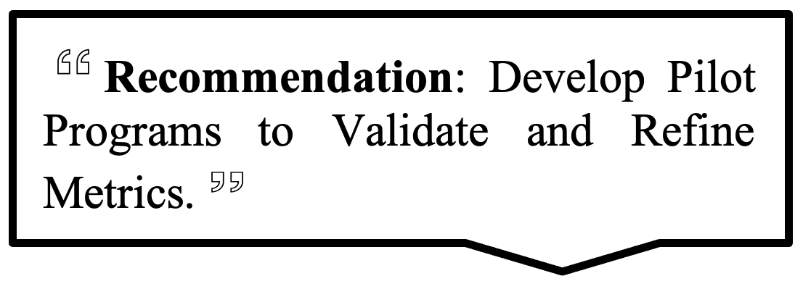
RECOMMENDATIONS
From Labs to
Legislation
7

Slide 8
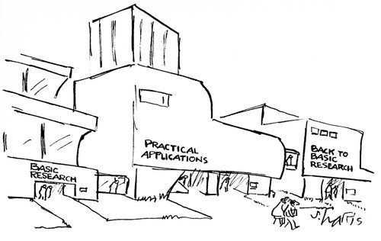
EXPECTED OUTCOMES
Higher-quality research outputs from United States universities
Improved alignment between government policy and university research activities.
Reinforced U.S. global leadership
in scientific innovation and
technological advancement.
From Labs to
Legislation
8

Slide 9
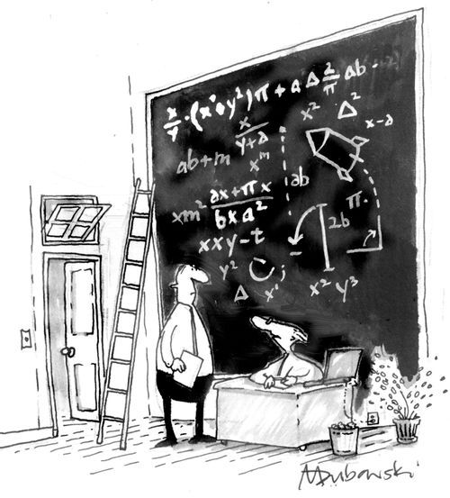
Thank you.
Daniil Rose – daniil.rose@posteo.org

